Slide 1


Department of Computer Science and Engineering
BLOCKCHAIN-BASED E-VOTING SYSTEM WITH FACE RECOGNITION
Team Members Name / Register Number
C.RATHIKA - 211419104218
J.SHANGEETHA - 211419104246
Guide Name & Designation
Coordinator Name & Designation
MRS V.SATHYA PREIYA ME (Phd)
Dr.K.VALARMATHI ME PhD

Slide 2
INTRODUCTION
Electronic voting has emerged over time as a replacement for paper-based voting to reduce redundancies and inconsistencies.
The historical perspective presented in the last two decades suggests that it has not been so successful due to the security and privacy observed over time.
This paper suggests a framework by using effective hashing techniques to ensure the security of the data. The concept of block creation and block sealing is introduced in this paper.
The introduction of a block sealing concept helps in making the block chain adjustable to meet the need of the polling process.
The use of consortium block chain is suggested, which ensures that the blockchain is owned by a governing body (e.g., election commission), and no unauthorized access can be made from outside.
The framework proposed in this paper discusses the effectiveness of the polling process, hashing algorithms' utility, block creation and sealing, data accumulation, and result declaration by using the adjustable blockchain method.
This paper claims to apprehend the security and data management challenges in block chain and provides an improved manifestation of the electronic voting process.

Slide 3
OBJECTIVE OF THE PROJECT
Providing a safe and transparent framework for holding elections is the goal of a blockchain-based face-recognition e-voting system. Some of the main goals of such a strategy include the following: Ensuring Transparency: Making sure of openness With all transactions being logged on the blockchain in a way that cannot be altered, the blockchain-based electronic voting system with face recognition seeks to provide transparency in the electoral process. Offering protection: The system should make sure that there are no fraud attempts being made and that the voting process is safe. Voter identification can be confirmed with the aid of facial recognition technology, and the blockchain can guarantee precise vote counting. Providing accessibility: Regardless of a person's physical position, the system should be made accessible. This indicates that electors ought to have the option of casting their ballots electronically using a computer or mobile device. Cost-saving: A blockchain-based e-voting system with face recognition can assist in lowering the costs related to holding an election, including printing and distributing ballots, setting up polling places, and employing staff. Increasing trust: By offering transparency and security, lowering the possibility of fraud or manipulation, and boosting voter confidence in the accuracy of the outcomes, the use of blockchain technology can help increase trust in the election process.

Slide 4
LITERARTURE SURVEY
YEAR | TITLE AND JOURNAL PAPER | DESCRIPTION | ADVANTAGES | DISADVANTES
2023 | Online Voting System using Face Recognition and Blockchain | A method for conducting safe and open elections is the Online Voting method using Face Recognition and Blockchain. Face recognition technology is used to confirm voter identification, and blockchain technology is used to record and validate voting data. | The system is accessible to a broader variety of voters, including those who might have trouble getting to traditional polling places, due to its online nature. | Some voters might not be acquainted with the technology employed in the system, which could make it difficult for them to use it and possibly reduce their involvement in the voting process.

Slide 5
LITERARTURE SURVEY
YEAR | TITLE AND JOURNAL PAPER | DESCRIPTION | ADVANTAGES | DISADVANTES
2022 | A Framework to Make Voting System Transparent Using Blockchain Technology | The use of smart contracts to automate voting and guarantee the validity of the results is one of the technical components of the proposed framework that are covered in the article. The authors also advocate using face recognition technology to authenticate voters, which can stop fraudulent practices like impersonation and double voting. | The voting method is secure because to the use of blockchain technology, making it harder for hackers to tamper with the results. | A high level of technical expertise is needed to create and maintain the proposed framework because it is challenging and novel.

Slide 6
LITERARTURE SURVEY
YEAR | TITLE AND JOURNAL PAPER | DESCRIPTION | ADVANTAGES | DISADVANTES
2021 | Face Recognition Algorithms: A Review | Eigen faces follows an appearance-based approach. In this method face detection and recognition is performed by detecting the variations of faces in a collection of images. | The face is an important part of human being which represents the unique identity. Quick and easy recognition of a person is possible through one’s face | Over the years after several researches, face recognition became one of the most studied research areas in the field of computer vision

Slide 7
PROBLEM STATEMENT
The need for a safe, transparent, and effective electronic voting system that protects voters privacy and anonymity while also discouraging fraud, tampering, or manipulation of the results of the election can be summed up as the problem statement of a block chain-based e-voting system with recognition.
Long lines, improper handling of ballots, inaccurate counting, and security lapses are just a few of the drawbacks of the present voting system.
By guaranteeing that only authorized voters can engage in the voting process, the use of recognition technology, such as facial recognition or biometric verification, can also improve the security of the system.
But putting such a system into place necessitates addressing issues like guaranteeing the privacy and anonymity of voters, stopping voting twice, and safeguarding the system from cyber-attacks.
Therefore, the problem statement of a block chain-based electronic voting system with recognition is to design and develop a secure, transparent, and effective electronic voting system that guarantees the voters privacy and anonymity while also preventing fraud, tampering, or manipulation of the election results.

Slide 8
PROPOSED SYSTEM
The proposed system is the face Verified online voting system with Face Verification using Block chain Addresses.
It determines the particular voter by his/her Block chain Address whether he/she is a valid voter or not. It allows the particular voter to cast the vote online.
The polling process continues until the voting time ends and updates the database in the server. Face Verification online voting system uses Block chain Address to retrieve the complete details about the voter.
And the votes are stored in a block chain server and viewed by the public this ensures a trustworthy environment.

Slide 9
SOFTWARE / HARDWARE USED
Software Requirements
Ø Windows 10 and above
Ø JDK 1.8
Ø Python 3.6.3
Ø XAMPP
Ø GanaChe
Hardware Requirements
Ø Hard Disk : 80GB and Above
Ø RAM : 4GB and Above
Ø Processor : P IV and Above

Slide 10
EXISTING ALGORITHM
Digital signature algorithm: RSA, DSA, and ECDSA are three popular digital signature algorithms. Algorithms for public key cryptography include the Elliptic Curve Cryptography (ECC), RSA, and Diffie-Hellman secret exchange. Proof of Work (PoW), Proof of Stake (PoS), and Delegated Proof of Stake are common consensus methods used in blockchain networks. (DPoS).

Slide 11
PROPOSED ALGORITHM
SHA256 algorithm has been used to hash the data.
K Nearest Neighbor (KNN) is a very simple, easy-to-understand, and versatile machine learning algorithm used in many different areas, such as handwriting detection, image recognition, and video recognition.
KNN is most useful when labeled data is too expensive or impossible to obtain, and it can achieve high accuracy in a wide variety of prediction-type problems.

Slide 12
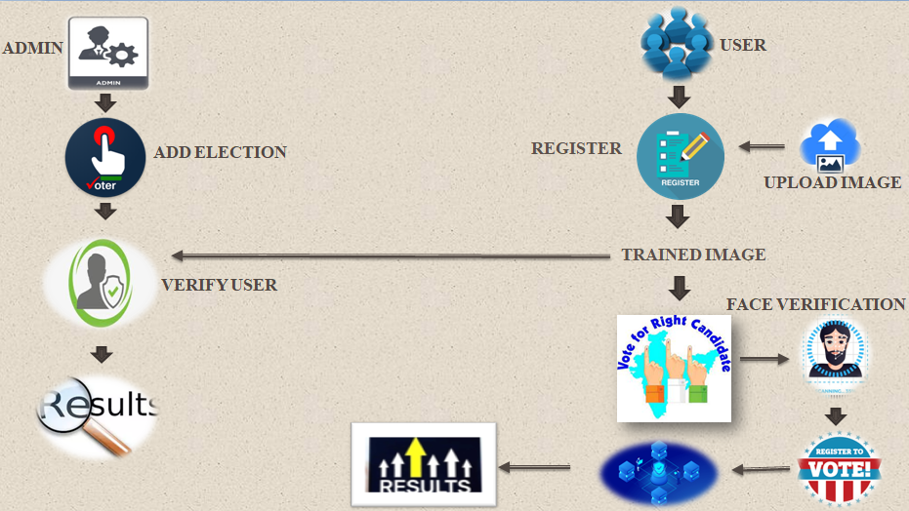
ARCHITECTURE DIAGRAM

Slide 13
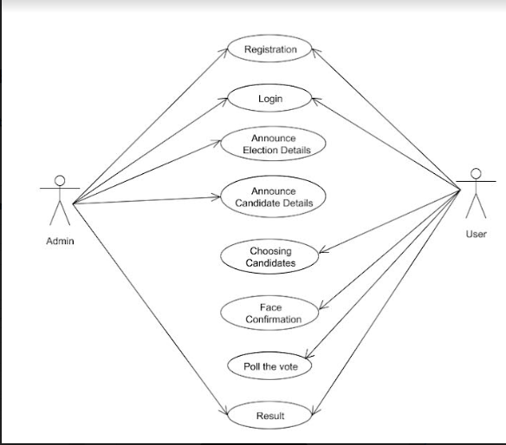
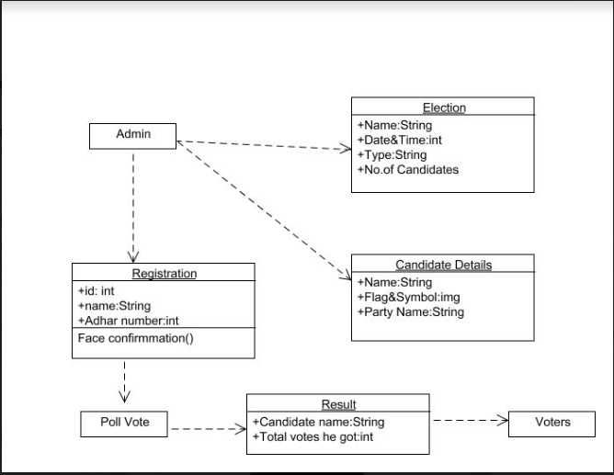
USECASE DIAGRAM
CLASS DIAGRAM

Slide 14
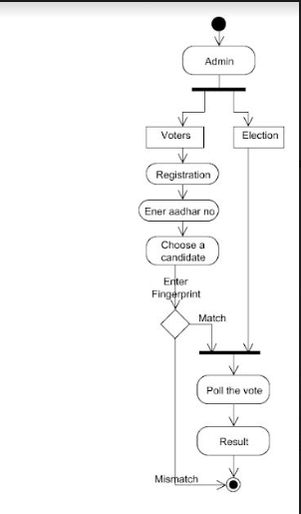
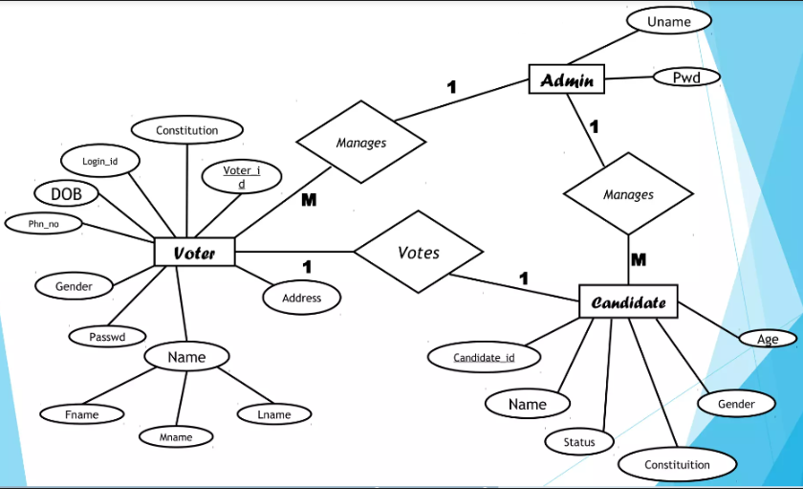
ACTIVITY DIAGRAM
ENTITY RELATIONSHIP DIAGRAM (ERD)

Slide 15
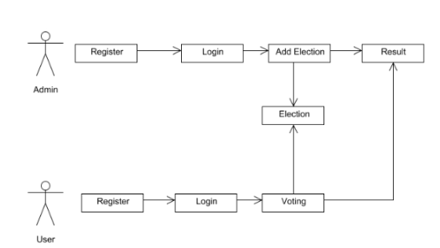
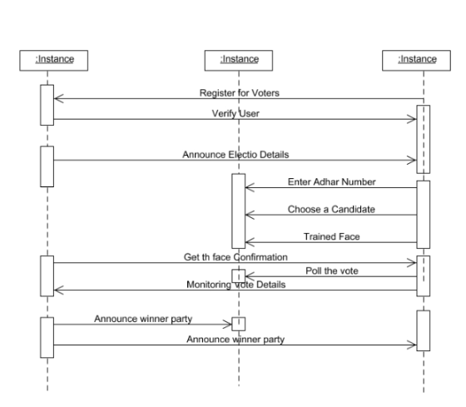
COLLABRATION DIAGRAM
SEQUENCE DIAGRAM

Slide 16
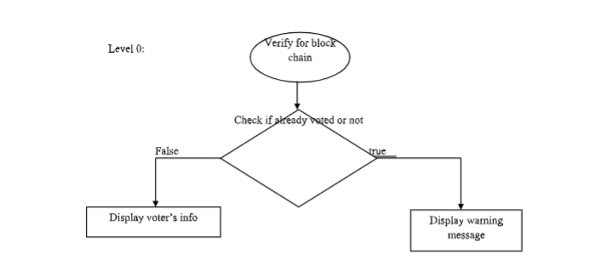
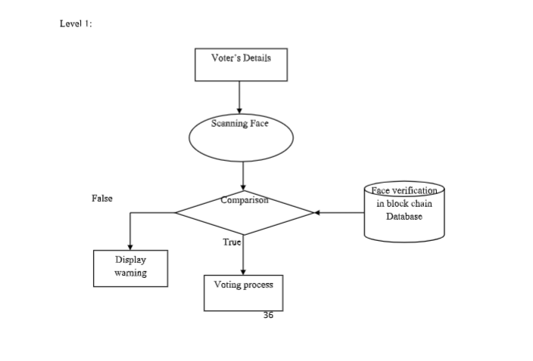
DATA FLOW DIAGRAM
LEVEL 0
LEVEL 1

Slide 17
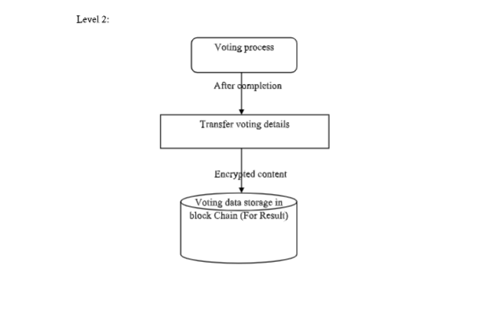
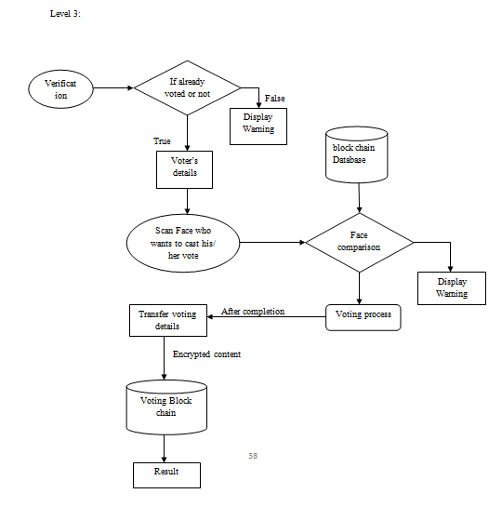
DATA FLOW DIAGRAM
LEVEL 2
LEVEL 3

Slide 18
MODULE DESCRIPTION
User Registration & Trained Voter Face
Create Election
Voting
Publish Result
MODULE 1
User Registration & Trained Voter Face:
User should register in our website (User Voting Page Way) Block chain as an initial step with their mobile name, email, aadhar id, Voter id , image Area, Block chain Address contact number to which an unique USER-ID register. Users who are all registered in this portal are also considered as voter. The voter image convert to trained image After registering successfully the admin verify the voter details, after user can login into their profile using their USER-ID and their registered password.
ADMIN:
Admin Login page with default user name and password. Admin can accept or reject an voter request by verifying the user detail and also admin can register another admin. User has to scan his aadhar card for verification process. After scanning he should enter his detail and send an request to the admin if the account get rejected due to some reason he will be intimated to register again by admin.

Slide 19
MODULE DESCRIPTION
MODULE 2
Create Election
The Admin can create an election with election type and election constituency. All the election gets triggered at the given date and time. And Verified user has to login and scan his Block chain Address if election and user constituency matches user can view Election details. And Block chain Address. To create Nominated account in block chain.
MODULE 3
Voting:
Voters must have access to any web browser to take part in voting. The voter's interface would be provided in English language to make it easy to use for all users. The proposed system can contain a large number of voters at the time of voting. A decentralized block chain system enables a voter to vote from any part of the world. A person can take part in voting from anywhere, even if he is in a foreign country, in this way his/her computerized National ID is verified from the national database so he can cast the vote.
User has to face his registered finger during his registration process. In voting page voter has to scan his face if the User Face matches with registered Face , voter can cast his or her vote to the right candidate Source KNN an algorithm for recognition of human face is used to compare two Face.

Slide 20
Module Description
Voting transactions are sent to a pool from which miners analyze them and remove the malicious request by taking the
consensus from the other nodes before adding it to the chain. The votes are fully secured using a cryptographic hash. Each vote cast adds a new block in the chain. When the transaction completes and a node is successfully added to Vote Chain, the voter of that particular voting transaction is notified through an SMS to his registered email. The voter has provided with a unique transaction hash by which he can verify his vote through a web portal and
upon successfully completion of transaction the vote has been counted in the whole voting activity.
MODULE 3
Publish Result:
Smart contracts are providing a secure connection between the user and the network while executing a transaction in the chain. These are the rules that are implemented on the entire
Block chain and cannot be neglected under any condition. All the nodes have to follow the smart contracts to save the vote in the system successfully. When user completes his or her voting process votes are stored in Block chain. So the voter can trust his votes stored in block chain cannot be changed

Slide 21
MODULE DESCRIPTION
User can view his or her vote in a pie chart retrieved from block chain.SHA256 algorithm has been used to hash the data. Admin Can publish the result of each constituency after the election process is fully completed.

Slide 22
TESTING AND RESULTS
TEST CODE | TEST CASE | INPUT | STEPS | OUTPUT | PASS/FAIL
1. | Verification of voter identity | Voter's face image and personal information | 1. Enter the voter's personal information into the e-voting system. 2. Submit the voter's face image for verification. 3. Check if the voter's identity is confirmed. 4. Verify that only eligible voters are allowed to vote. | Whether the voter is authenticated and eligible to vote | PASS
2. | Casting a vote | Voter's choice of candidate or proposal | 1. Display the options available for the voter to choose from 2. Allow the voter to select their preferred candidate or proposal 3Record the voter's choice on the blockchain 4. Verify that the vote is successfully recorded and cannot be tampered with | The vote is recorded on the blockchain | PASS

Slide 23
TESTING AND RESULTS
3. | Counting votes | The recorded votes on the blockchain | 1. Retrieve all the recorded votes from the blockchain. 2. Count the number of votes for each candidate or proposal. 3. Calculate the total number of votes cast in the election. 4. Declare the winner or result based on the counting. | The final election results | PASS
4. | Security and privacy | Various attempts to hack the system or access personal information | 1. Attempt to hack the e-voting system using various methods (e.g., brute-force attack, injection attack, etc.) 2. Verify that the system remains secure and cannot be breached 3. Attempt to access personal information of voters without proper authorization 4. Verify that the system maintains the privacy and confidentiality of voters' personal information. | The system remains secure and private | PASS

Slide 24
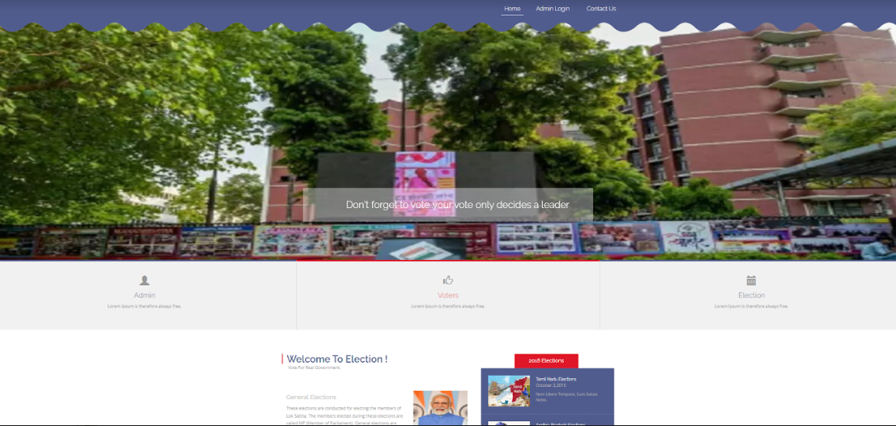
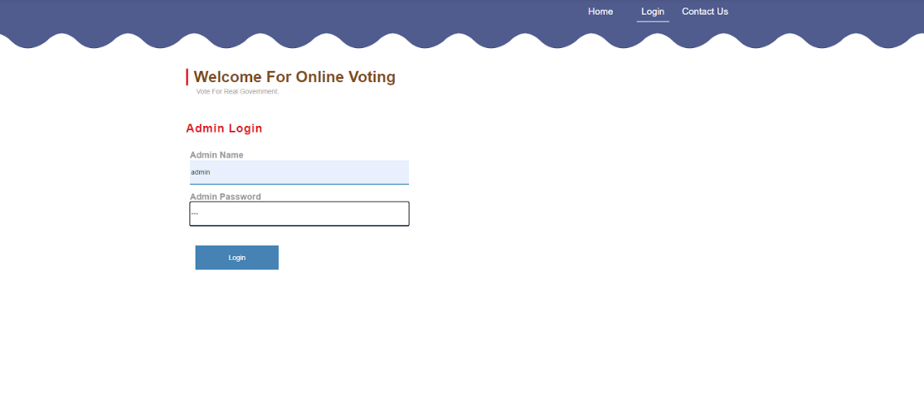
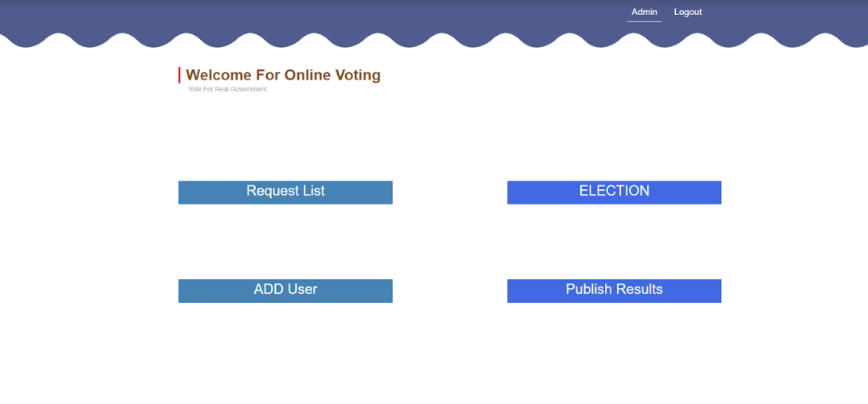
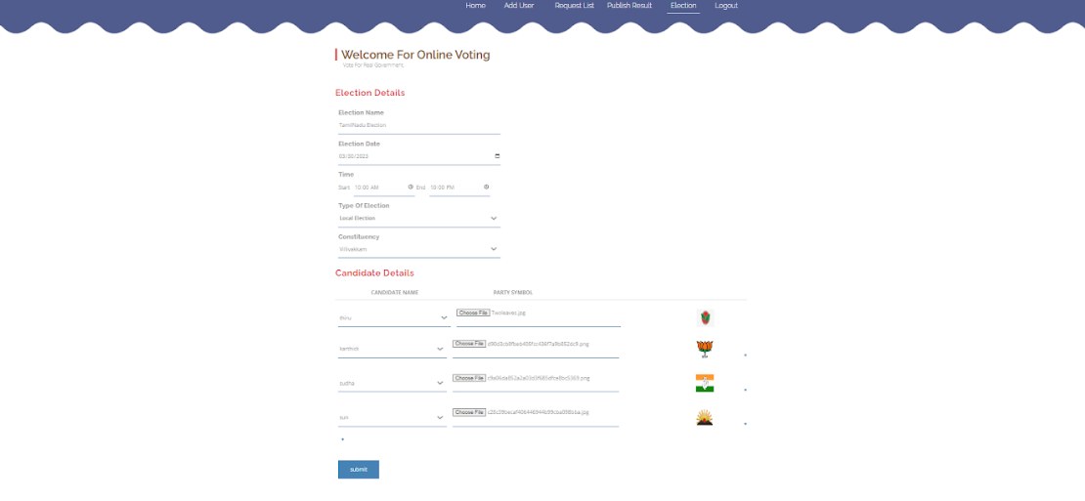
SCREEN SHOTS
HOME SCREEN FOR ADMIN PAGE
ADMIN LOGIN
ADMIN PAGE
ELECTION DETAILS

Slide 25
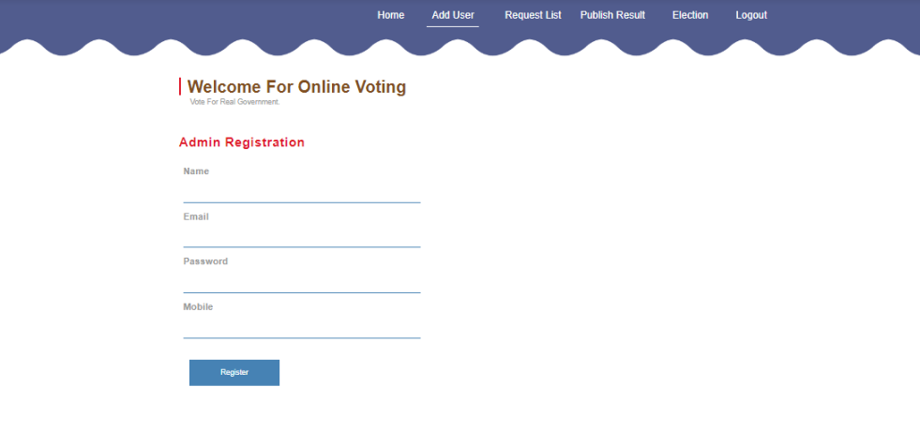
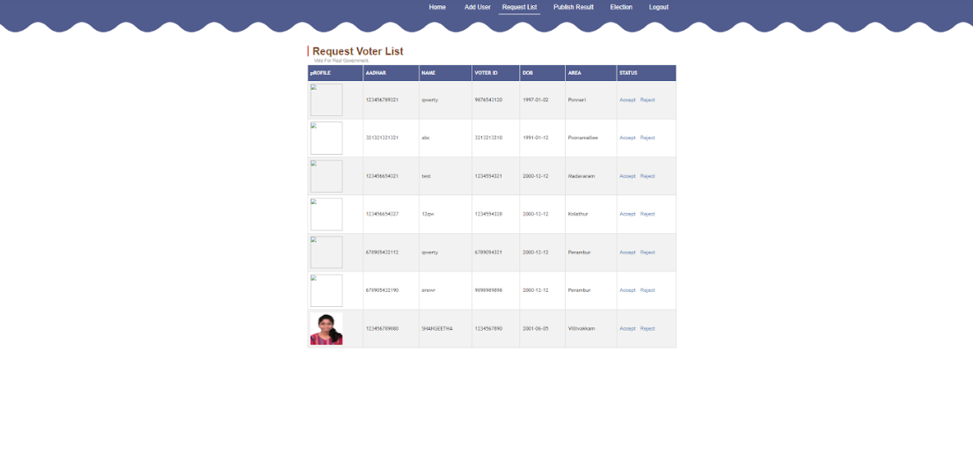

ADMIN REGISTRATION
ADMIN LOGIN
REQUEST VOTER LIST
PUBLISH ELECTION RESULT

Slide 26
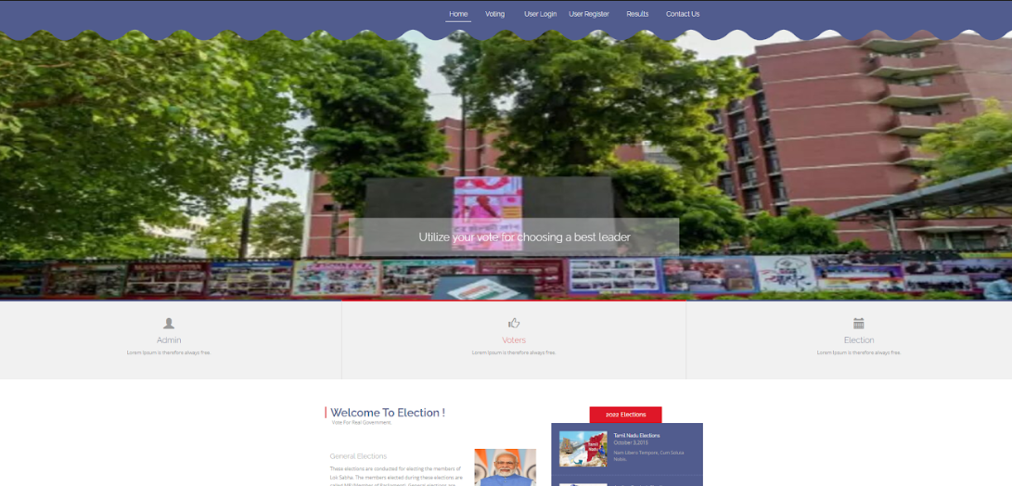
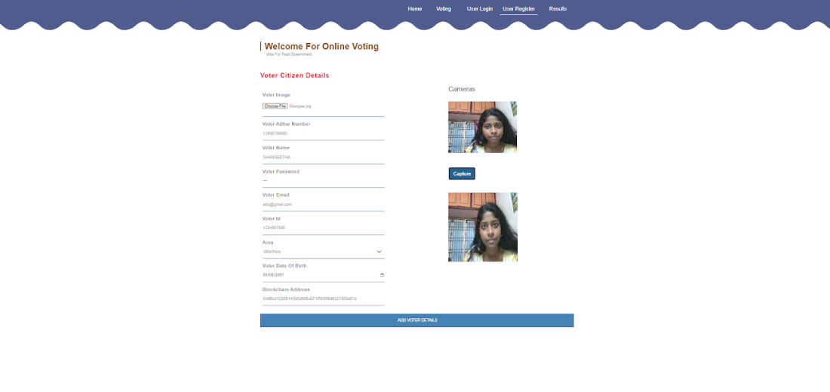
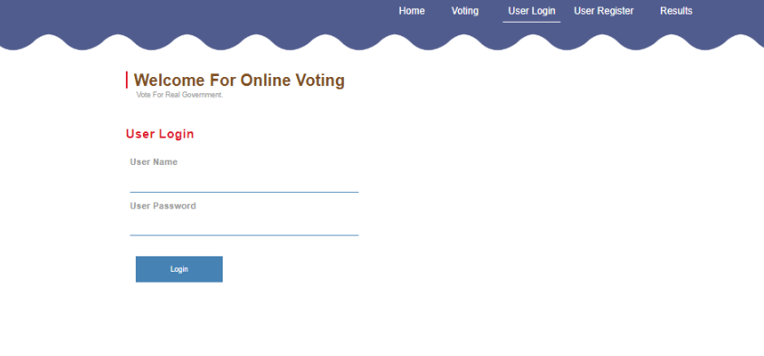
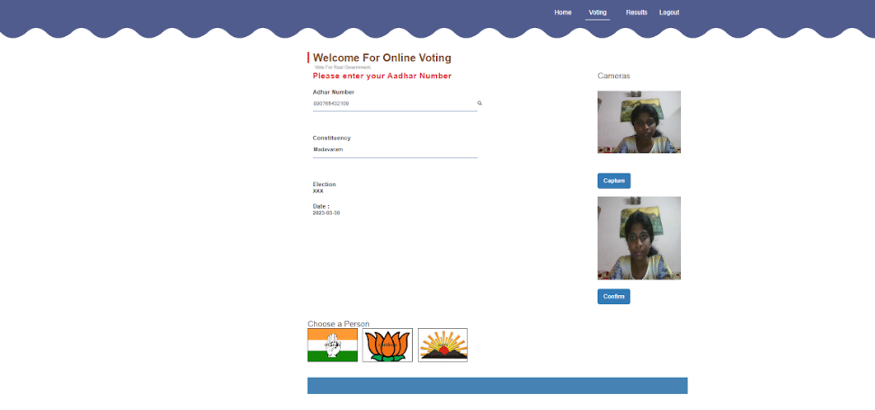
HOME SCREEN FOR USER PAGE
USER REGISTRATION
USER LOGIN
VOTING

Slide 27
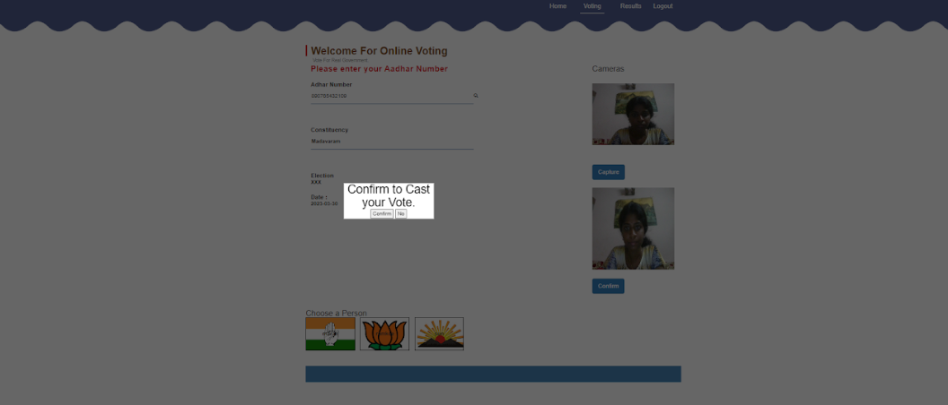
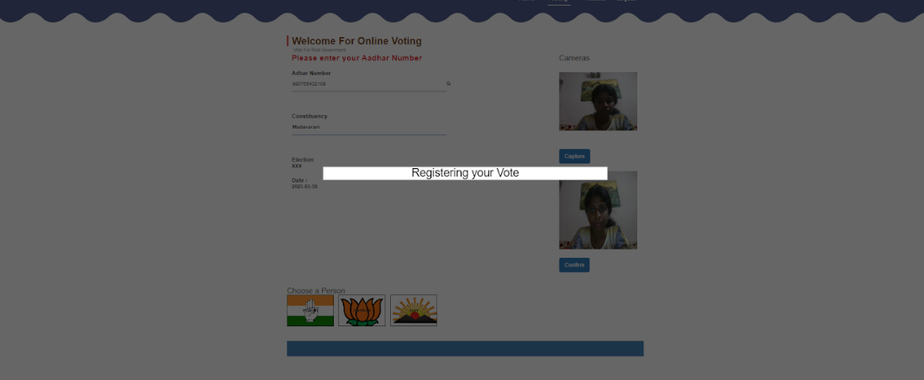
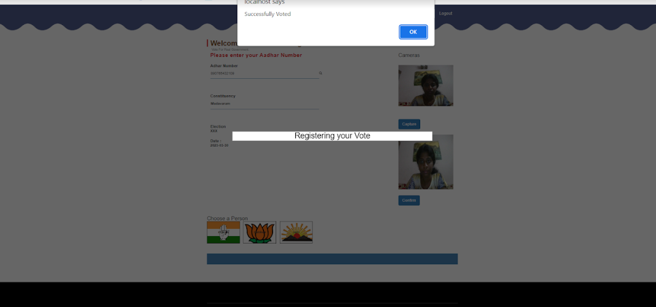
CONFIRMING VOTE
REGISTERING VOTE
SUCESSFULLY VOTED

Slide 28
CONCLUSION
The purpose of proposing a block chain-based solution for the voting system was to build trust between government and voters to make-believe that their voting integrity is kept safe. The block chain-based voting is also make the voting process transparent and trustworthy. Our proposal enables a voter to cast his/her vote through internet without going to voting booth and additionally registering himself/herself for voting in advance, proxy vote or double voting is not possible, fast to access, highly secure, easy to maintain all information of voting, highly efficient and flexible. Hence, by this voting percentage will increase drastically. The using of online voting has the capability to reduce or remove unwanted human errors. In addition to its reliability, online voting can handle multiple modalities, and provide better scalability for large elections. Online voting is also an excellent mechanism that does not require geographical proximity of the voters. For example, soldiers abroad can participate in elections by voting online.

Slide 29
FUTURE ENHANCEMENTS
These are all potential ways to improve the security and reliability of a blockchain-based face-verified e-voting system:
Integration with mobile devices: By allowing voters to cast their ballots using their mobile devices, the e-voting platform could increase voter turnout and convenience.
Use of AI-based face recognition: AI-based face recognition technology could increase the precision and effectiveness of face verification, even in low light or when a voter is wearing a mask.
I Integration with additional biometric information: Integrating voice or fingerprint recognition could further improve the security and accuracy of the voter identification process.
Decentralized identity management: A decentralized identity management system could provide voters with greater control and protection over their personal data, which is currently managed by centralized voter administration and registration.
V. Monitoring the results in real-time: Real-time monitoring of results could increase the system's accountability and transparency, allowing voters and other interested parties to observe the results as they are tallied.

Slide 30
REFERENCES
A. Barnes, C. Brake, and T. Perry. Digital Voting with the use of Blockchain Technology Team Plymouth Pioneers-Plymouth University. Accessed: Feb. 14, 2022. [Online]. Available:
https://www.economist.com/sites/default/files/plymouth.pdf
D. Chaum, A. Essex, R. Carback, J. Clark, S. Popoveniuc, A.Sherman, and P. Vora, ‘‘E-voting 40 scantegrity: End-to-end voter-verifiable optical-scan voting,’’ IEEE Secure. Privacy, vol. 6, no. 3,
pp. 40–46, Accessed: Feb. 14, 2021. [Online]. Available:
https://www.computer.org/security/
S. Park, M. Specter, N. Narula, and R. L. Rivest, ‘‘Going from bad to worse:
From internet voting to blockchain voting,’’ J. Cyber security, vol. 7, no. 1,
pp. 1–15, Feb. 2021, doi: 10.1093/cybsec/tyaa025.
T. Dimitriou, ‘‘Efficient, coercion-free and universally verifiable blockchain-based voting,’’ Comput. Netw., vol. 174, Jun. 2020, Art. no. 107234, doi: 10.1016/j.comnet.2020.107234.
M. S. Farooq, M. Khan, and A. Abid, ‘‘A framework to make charity collection transparent and auditable using blockchain technology,’’ Comput. Electr. Eng., vol. 83, May 2020, Art. no. 106588, doi: 10.1016/j.compeleceng.2020.106588.

Slide 31
THANK YOU

